Slide 1
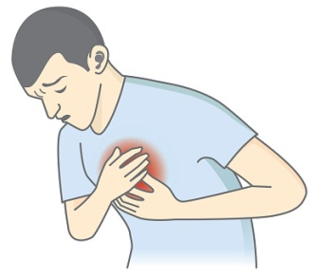
Before you see the GP, work out what you are worried about. Highlight your concerns. Think about how you would describe your symptoms. Get to the point don’t keep important information to the end.
TOO MANY PROBLEMS
DISTRACTS THE DOCTOR
ON DEALING WITH YOUR
MAIN PROBLEM
ONE APPOINTMENT
ONE PROBLEM
ONE PATIENT
IT IS TEMPTING TO BRING A LIST OF UNRELATED PROBLEMS, BUT CONSIDER WHATS ACHIEVABLE IN 10 MINUTES!
DOCTOR MAY BE
MORE LIKELY TO
RUSH
A SERIOUS ILLNESS
MIGHT GET MISSED

